Slide 1


Slide 2


Sponsored By

Slide 3

Ben Askren
Mobile app developer specializing in:
Application development for engineering and construction
Management and technical consulting
Xamarin enthusiast
Professional experience
Mechanical Engineer
Engineering R&D Manager
Entrepreneur
CTO

Slide 4
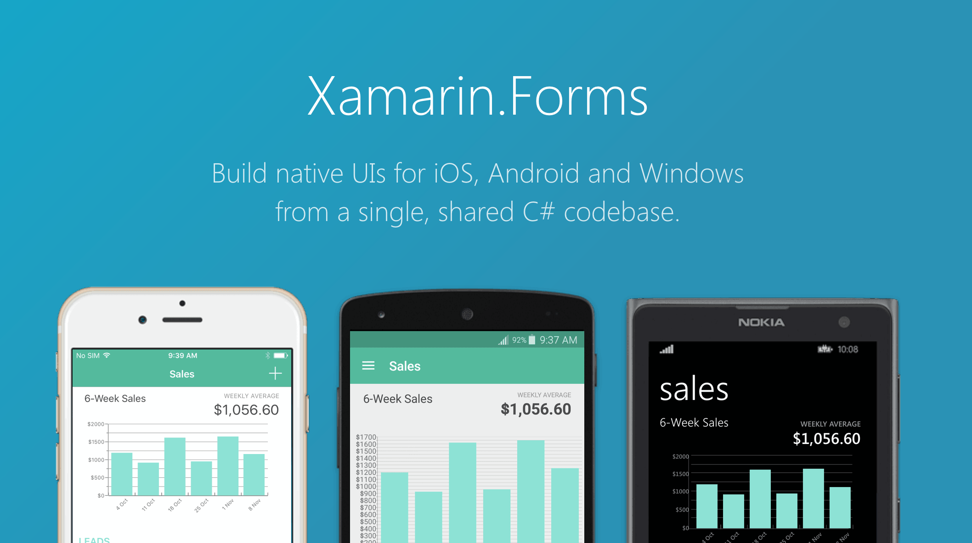

Slide 5
But what about a single, shared … images?

Slide 6
Xamarin.Forms.ImageSource
static factory methods:
FromStream
FromUri
FromFile
FromResource
Issues:
Native FromFile is plagued with platform specific idiosyncrasies.
All others have neither idiom nor display matching

Slide 7
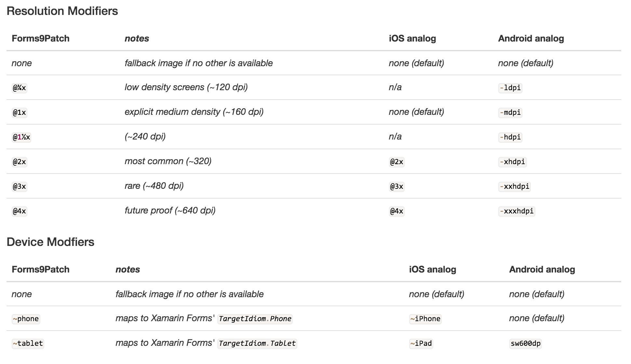
Forms9Patch.ImageSource.FromMultiResource

Slide 8
demo: Forms9Patch.ImageSource.FromMultiResource

Slide 9

Patch Scalable Images:
iOS: [UIImage resizableImageWithCapInsets:]
Android: *.9.png
WinRT/UWP: NineGrid Thickness
Xamarin.Forms:

Slide 10
demo: Forms9Patch.Image with 9Patch image

Slide 11
But what about a single, shared … popups?

Slide 12
Forms9Patch Popups
ActivityIndicatorPopup
ModalPopup
BubblePopup
Toast
TargetedToast
PermissionPopup

Slide 13
But what about single, shared … fonts?

Slide 14
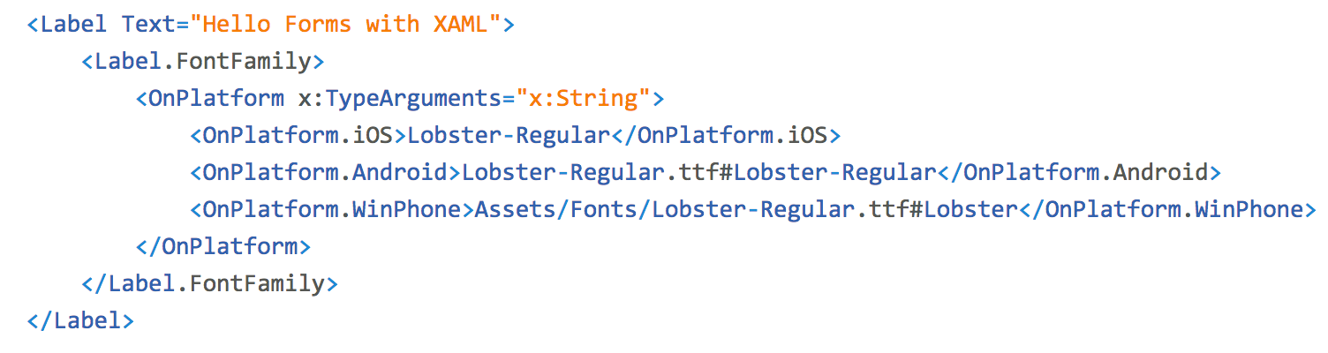
Xamarin.Forms.Label.FontFamily
Xamarin.Forms.Label

Slide 15
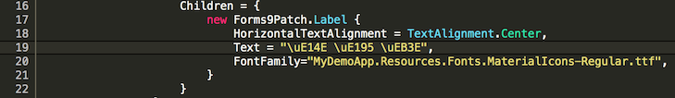

Forms9Patch.Label.FontFamily
Add your custom font as an embedded resource
Note the ResourceID of the font and use that for the FontFamily

Slide 16
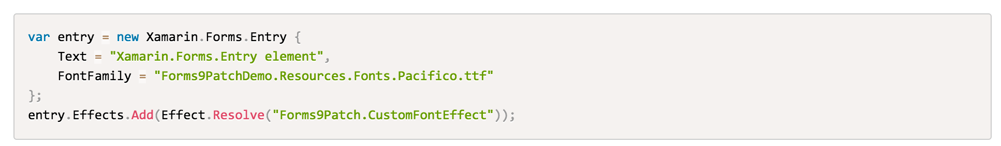
Forms9Patch.CustomFontEffect
Why not have that EmbeddedResource font magic elsewhere?

Slide 17
Why is auto-scale text missing?

Slide 18
Why is markup text missing?

Slide 19
Comparing FormattedStrings
Xamarin.Forms.Label.FormattedText
Xamarin.Forms.Span
Font, FontAttributes, FontFamily, FontSize, BackgroundColor
Forms9Patch.Label.HtmlString
Good old 1990s HTML markup
Tags:
<a>, <big>, <b>, <del>, <den>, <em>, <font>, <ins>, <i>, <num>, <pre>, <s>, <small>, <strike>, <strong>, <sub>, <sup>, <tt>, <u>
Attributes:
All tags: style (background-color, color, font-family, font-size, font-weight, font-style)
<font> tag: face, size, color

Slide 20
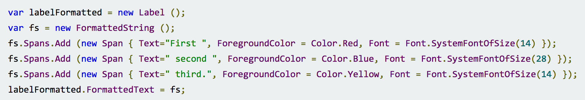
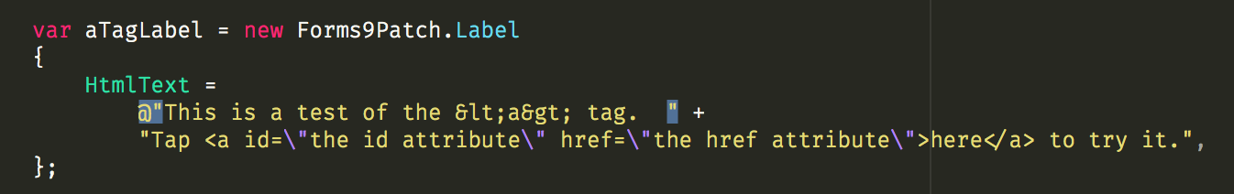
Comparing FormattedStrings
Xamarin.Forms.Label.FormattedText
Forms9Patch.Label.HtmlString

Slide 21
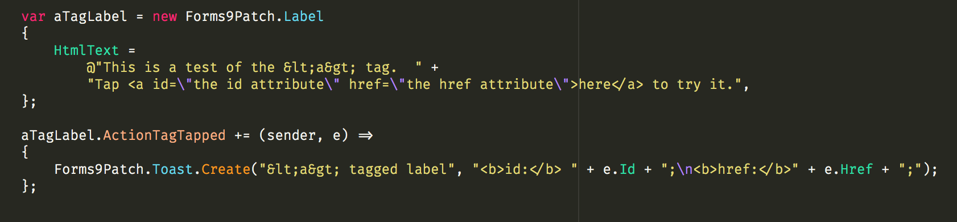
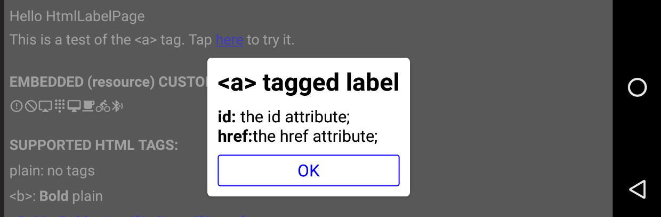
Forms9Patch.Label.HtmlText <a> tag

Slide 22
Mixing things up …

Slide 23
Why are button layout options missing?

Slide 24
Why are segmented buttons missing?

Slide 25
Why are stateful buttons missing?

Slide 26
Why are stateful buttons missing?

Slide 27
More goodies …

Slide 28
Forms9Patch “Services”
Application Information Service
Static properties: Name, Identifier, Build, Version
Key Clicks Service
Static method: Feedback(HapticEffect effect, KeyClicks mode)
Keyboard Service
Static methods: Hide()
Static properties: Hidden, Shown
Display Service (soon to be moved to FormsGestures)
Static properties: Scale, Width, Height

Slide 29
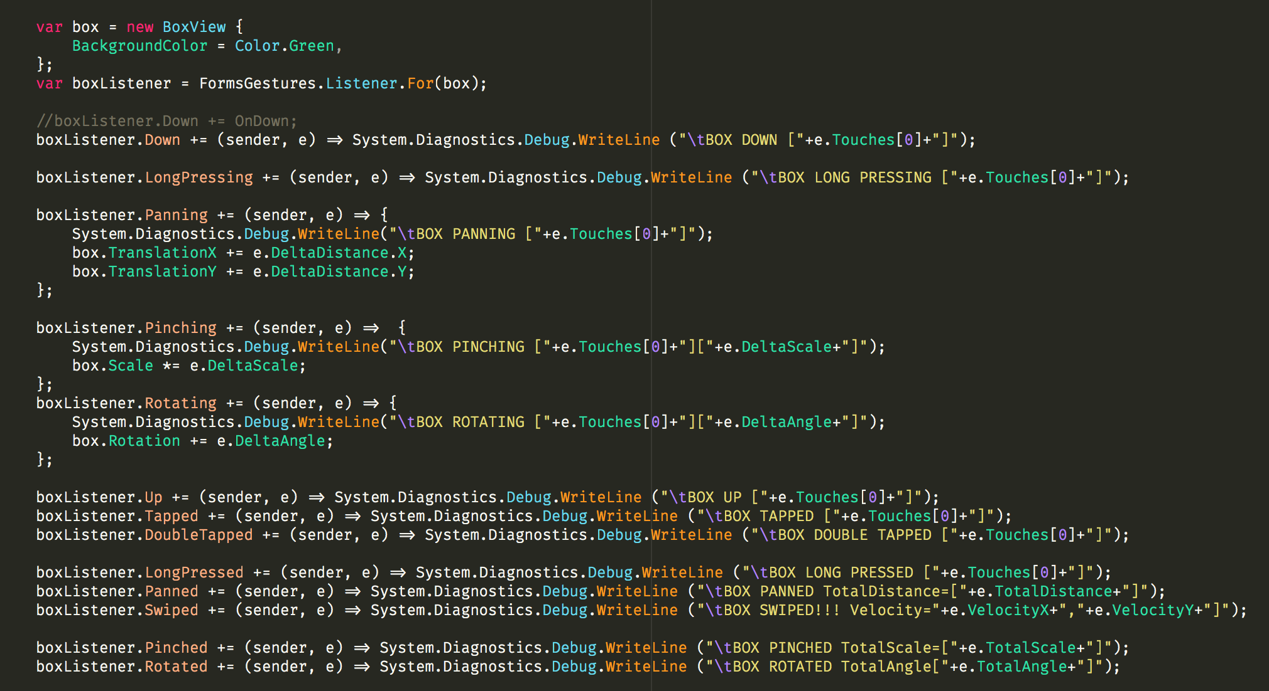
Poorly documented freebie: FormsGestures

Slide 30
Undocumented freebie: PCL.Utils
FileCache
public static async Task<string> Download(string url)
ReflectionExtensions
public static PropertyInfo GetPropertyInfo(this Type type, string propertyName)
public static FieldInfo GetFieldInfo(this Type type, string fieldName)
public static MethodInfo GetMethodInfo(this Type type, string methodName)
public static List<string> PropertyNames(this object obj )
public static bool PropertyExists(this object obj, string propertyName)
public static object GetPropertyValue(this object obj, string propertyName)
public static void SetPropertyValue(this object obj, string propertyName, object val)
public static object GetFieldValue(this object obj, string fieldName)
public static void SetFieldValue(this object obj, string fieldName, object val)
public static object GetFieldValue(this Type type, string fieldName)
public static object GetPropertyValue(this Type type, string fieldName)
public static object CallMethod(this object obj, string methodName, object[] parameters)
public static Assembly GetApplicationAssembly()

Slide 31
OK, you think F9P is so great. Why is UWP missing?

Slide 32
Thank You!

